Slide 1
Home Automation
Project Category : Automation
Group Leader : Shivankit Gaind
Group Members:
Anmol Singhal
Ananyashree Garg
Notes:
This template can be used as a starter file for presenting training materials in a group setting.
Sections
Right-click on a slide to add sections. Sections can help to organize your slides or facilitate collaboration between multiple authors.
Notes
Use the Notes section for delivery notes or to provide additional details for the audience. View these notes in Presentation View during your presentation.
Keep in mind the font size (important for accessibility, visibility, videotaping, and online production)
Coordinated colors
Pay particular attention to the graphs, charts, and text boxes.
Consider that attendees will print in black and white or grayscale. Run a test print to make sure your colors work when printed in pure black and white and grayscale.
Graphics, tables, and graphs
Keep it simple: If possible, use consistent, non-distracting styles and colors.
Label all graphs and tables.

Slide 2
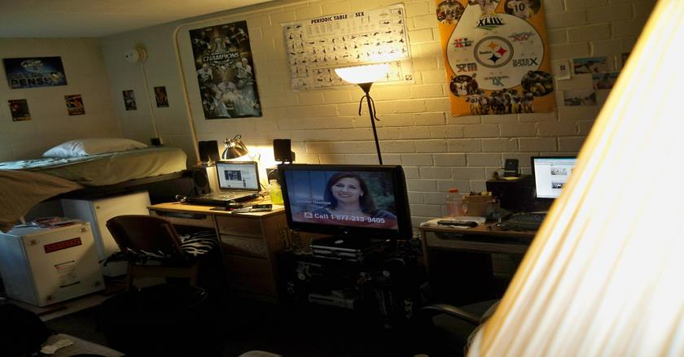
CURRENT SCENARIO
Wastage of electricity is one of the main problems which we are facing now a days. In our home, school, colleges or industry we see that fan / lights are kept on even if there are nobody in the room or area / passage.
Notes:
Give a brief overview of the presentation. Describe the major focus of the presentation and why it is important.
Introduce each of the major topics.
To provide a road map for the audience, you can repeat this Overview slide throughout the presentation, highlighting the particular topic you will discuss next.

Slide 3

OBJECTIVE
The aim of our project is to
make a controller which can sense if any person enters the room and it lights up the room automatically and also counts how many person are entering the room or going out of it. It is made to prevent unwanted power wastage in schools, offices, colleges and houses. This process is operated automatically by its sensors.
Notes:
This is another option for an Overview slides using transitions.

Slide 4
COMPONENTS USED TO BUILD
PROTOTYPE
Arduino UNO
IR Proximity Sensors
Breadboard
Jumper Wires
LED
Power Source for Arduino

Slide 5
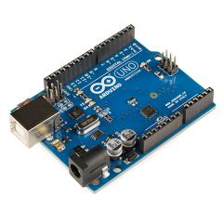
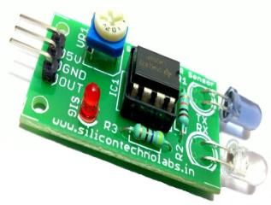
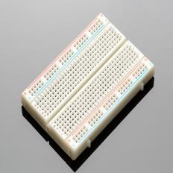
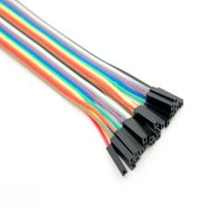
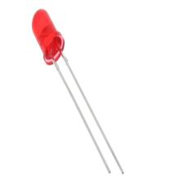


Slide 6

Basic Explanation of the Project

Slide 7
A proximity sensor often emits an electromagnetic field or a beam of electromagnetic radiation (infrared, for instance), and looks for changes in the field or return signal. Two proximity sensors are mounted just below the handle of the door so that when a person opens the door using the handle the proximity sensor shows a change in its output level.
Notes:
This is another option for an Overview slide.

Slide 8
The arduino is coded in such a way that it leads to automatic switching of lights and fans in the room depending on the presence of humans by receiving and sending analogue signals.
Notes:
What will the audience be able to do after this training is complete? Briefly describe each objective how the audience will benefit from this presentation.

Slide 9
ALGORITHM
There are two IR sensors which act as a bidirectional visitor counter.
If the person enters the room, the Front sensor will get detected first and the back one will get detected later since they are separated by a little distance. The program is such that this will lead to increment of the counter variable by 1.
But if the reverse happens i.e if the person leaves the room, it leads to counter decrement.

Slide 10
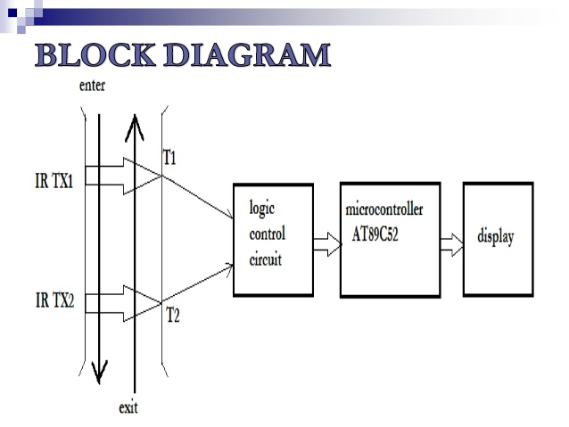

Slide 11
Since the sensors are separated, there is a possibility that the person passes by the door itself and only one of the IR beams is interrupted. So we have overcome this limitation in our project by not incrementing and decrementing the counter in such a case.

Slide 12
FEASIBILITY
Notes:
Use a section header for each of the topics, so there is a clear transition to the audience.

Slide 13
The components used in the project like arduino, IR sensors etc. are cheap and easily available in the market.
Hence the implementation of the project is affordable. Also the IR based sensing system in combination with arduino has a lot of scope in further research and can lead to automation in various fields of life.
Notes:
Add slides to each topic section as necessary, including slides with tables, graphs, and images.
See next section for sample table, graph, image, and video layouts.

Slide 14
Real life implementation
Notes:
Use a section header for each of the topics, so there is a clear transition to the audience.

Slide 15
Digital Visitor Counter can be used in various rooms like seminar hall, conference hall where the capacity of room is limited and should not be exceeded. Project will display actual number of persons inside the room.
“Automatic Room light Controller with Visitor Counter” can be used in class rooms, study rooms in colleges.
Notes:
Add slides to each topic section as necessary, including slides with tables, graphs, and images.
See next section for sample table, graph, image, and video layouts.

Slide 16
Also in the places where there is only one door for entrance and one door for exit, we can install one sensor at the entrance door which acts as a positive counter and the other at the exit door which acts as a negative counter. This is a simpler version of the algorithm and we can lead to automation as per our needs.
Notes:
Add slides to each topic section as necessary, including slides with tables, graphs, and images.
See next section for sample table, graph, image, and video layouts.

Slide 17
FUTURE DEVELOPMENT and Enhancements

Slide 18
We can add Light Dependent Resistor (LDR) in this project.
Purpose of LDR: Light sensor – LDR will detect the sunlight in the room (or we can say LDR is used to detect daytime)
If there is enough sunlight in the room (which means it is a daytime) then the relay will not be turned on even if the person count is greater than zero. In this mode it will work only as a Person counter to save the electricity and works as energy saver. And if there insufficient sunlight in the room then only the relay will be turned on so as to turn on the bulb.
Notes:
Add slides to each topic section as necessary, including slides with tables, graphs, and images.
See next section for sample table, graph, image, and video layouts.

Slide 19
Voice alarm system can be added to indicate that room is full & persons can’t enter inside.
We can interface GSM modem to send this data through SMS.
Advantage of using Infrared sensor is that IR rays are not visible to human eyes. Also IR rays are not affected by any other sources. For example: If you use LDR as a sensor then it can be easily triggered by sunlight or any other sources of light
Notes:
Add slides to each topic section as necessary, including slides with tables, graphs, and images.
See next section for sample table, graph, image, and video layouts.

Slide 20
LIMITATIONS And IMPROVEMENTS REQUIRED

Slide 21
This system will not differentiate between a person and any other obstacle interrupting the sensors.
Also this circuit is good enough for only one person entering at a time. If multiple persons enter at the same time, they will be counted as only one
Also, this is a short range system. For long range, we use lasers.
For overcoming these problems with this system, further improvements can being done. Cameras and processing can be used to differentiate between different interruptions.
Notes:
Add slides to each topic section as necessary, including slides with tables, graphs, and images.
See next section for sample table, graph, image, and video layouts.

Slide 22
Thank you

